Slide 1
Motivations to volunteer: The case of Armenia
Turpanjian Center for Policy Analysis
American University of Armenia
Valentina Gevorgyan
vgevorgyan@aua.am
20th Annual Voluntary Sector and Volunteering Research Conference
September 10-11, 2014
Sheffield, UK

Slide 2
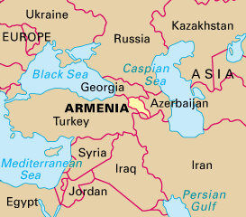
Armenia: historical overview
Independence 1991
Communist system
Weakness of civil society
Mistrust and low volunteering
Armenian civil society: volunteering
URL: http://placesbook.org/armenia (August 2014)

Slide 3
Motivations to volunteer: two perspectives
Volunteers at NGOs
Leaders of NGOs

Slide 4
Literature review: Motivations to volunteer
Six functions: values, understanding, enhancement, career, social and protective (Clary and Snyder 1999)
Altruism debate (Smith 1981; Pearce 1993)
Sacrifice and self-improvement (Wilson 2000)
Self-development and social ties (Thoits and Hewitt 2001; Salamon and Sokolowski 2003)
Willingness to help others (Rehberg 2005)
Altruism involved with each of the motivations (Burns et al. 2006)
Generosity and personal fulfillment (Skoglund 2006; Blanchard 2006)

Slide 5
Method
30 semi-structured interviews with volunteers
and leaders of NGOs
Data collected: October – December, 2013
Location: Yerevan (capital), towns of Armenia
Analysis: MaxQDA Qualitative software

Slide 6
Volunteers at NGOs
Motivations reported include:
Knowledge and skills
volunteering helps in gaining knowledge and developing skills
Work experience/career
volunteering compromises the lack of work experience
Values and enhancement
It is important to help others. It helps in acquiring moral gains
Social and protective functions
networking, better information, personal pleasure,
reducing negative feelings, a change

Slide 7
Leaders of NGOs
Motivations reported include:
Personal growth and development
learning new things and develop skills
Resume highlight and recommendation letter
for a line in resume and a signed recommendation letter
Interest and curiosity
to find out if their knowledge can be applied in a corresponding setting

Slide 8
Six functions served by volunteering (Clark and Snyder, 1999)
New knowledge and development of skills
Values (volunteers)
Understanding (leaders)
Enhancement (volunteers)
Career (volunteers & leaders)
Social (volunteers)
Protective (volunteers)

Slide 9
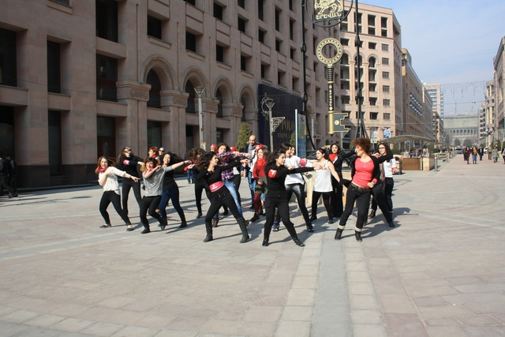
Tasks and duties of volunteers at NGOs
Organizational
Administrative
translation
preparation of invitations
online distribution of information
answering phone calls
making copies
participation in flash mobs
Dance Flash mob in Yerevan (Armenia 2014)
URL: https://witness.theguardian.com (August 2014)

Slide 10
“Volunteers are good, helpful and can do a very good job. But their job is going to be conditioned by small tasks such as holding posters and distributing information. When it comes to the hard work, one cannot rely on volunteering.”
media development NGO head, 46, male

Slide 11
Main findings
A. The main motivational factor to volunteer is to gain knowledge and develop skills, while the tasks and duties of volunteers are mainly administrative
B. NGO leaders consider volunteers’ motives to be self-oriented, while volunteers highlight an interplay of both self-oriented and altruistic reasons

Slide 12
Policy implications
manage volunteers’ expectations based on motivational needs
distribute tasks and assignments effectively
provide written policies and job descriptions for volunteers in advance
consider volunteers as a potentially valuable source for job recruitment in the future
provide additional responsibility and enable volunteers to 'grow' on the job
recognize and appreciate volunteers. Do it well: recognition activities,
for example training and professional development
acknowledge contributions. Think rewards: organizational strategies can support or discourage volunteering

Slide 13
Final reflections
A change in the way volunteering is developing nowadays: active youth (mainly under age of 30)
Properly matching organizational strategies with motivational needs of volunteers
More studies should be focused on volunteering in the region of the South Caucasus to encourage volunteering and nurture the development of democratic principles

Slide 14
Recommendation for further research
To develop tools to measure volunteers’ satisfaction with the knowledge gained and skills developed in their capacity of volunteers
To study the changes in motivation, satisfaction and organizational commitment
(both studies will necessitate an enquiry to volunteers having
a longer volunteering experience)

Slide 15
References
Aslanyan, Svetlana, Aharon Adibekian, Nelli Ajabyan, and Barbara A. Coe. 2007. Civil Society in Armenia: From a Theoretical Framework to Reality. Center for the Development of Civil Society. CIVICUS Civil Society Index. Yerevan, Armenia: Counterpart International. http://www.civicus.org/new/media/CSI_Armenia_Country_Report.pdf.
Blanchard, Judith A. 2006. “Hospital Volunteers: A Qualitative Study of Motivation.” The International Journal of Volunteer Administration 24 (2): 31–40.
Burns, David J., Jane S. Reid, Mark Toncar, Jeffrey Fawcett, and Cynthia Anderson. 2006. “Motivations to Volunteer: The Role of Altruism.” International Review on Public and Non-profit Marketing 3 (2): 79–91.
Clary, E. Gil, and Mark Snyder. 1999. “The Motivations to Volunteer Theoretical and Practical Considerations.” Current Directions in Psychological Science 8 (5): 156–159.
Hakobyan, Lusine, and Mane Tadevosyan. 2010. Culture of Volunteerism in Armenia. Case Study. Case Study. CIVICUS Civil Society Index. Yerevan, Armenia: Counterpart International. http://program.counterpart.org/Armenia/wp-content/uploads/2011/02/CSI-Case-Study-1.pdf.
Ochoa, Eduardo Lorenzo. 2012. Strengthening Civil Society and Its Interaction with State Institutions. Policy Paper. The European Neighbourhood Partnership Instrument for the Republic of Armenia. Yerevan: European Union Advisory Group to the Republic of Armenia. http://www.euadvisorygroup.eu/sites/default/files/REVISED%20DRAFT%20of%20Policy%20Paper%20on%20Strengthening%20Civil%20Society%20and%20its%20Interaction%20with%20State%20Institutions.pdf.
Paturyan, Yevgenya, and Valentina Gevorgyan. 2014. “Trust Towards NGOs and Volunteering in South Caucasus: Civil Society Moving Away from Post-Communism?” Southeast European and Black Sea Studies 14 (2): 239–262. doi:10.1080/14683857.2014.904544.
Pearce, Jone L. 1993. Volunteers: The Organizational Behaviour of Unpaid Workers. London and New York: Routledge.
Rehberg, Walter. 2005. “Altruistic Individualists: Motivations for International Volunteering Among Young Adults in Switzerland.” Voluntas: International Journal of Voluntary and Non-profit Organizations 16 (2): 109–122.
Salamon, Lester M., and S. Wojciech Sokolowski. 2003. “Institutional Roots of Volunteering.” In The Values of Volunteering: Cross-Cultural Perspectives, ed. Paul Dekker and Loek Halman, 71–90. New York: Springer.
Sargsyan, Lilith. 2012. “Key Motivational Drivers for Volunteering”. Yerevan, Armenia: American University of Armenia.
Skoglund, Andrea Galiette. 2006. “Do Not Forget About Your Volunteers: A Qualitative Analysis of Factors Influencing Volunteer Turnover.” Health and Social Work 31 (3): 217–220.
Smith, David H. 1981. “Altruism, Volunteers, and Volunteerism.” Non-profit and Voluntary Sector Quarterly 10 (1): 21–36.
Thoits, Peggy A., and Lyndi N. Hewitt. 2001. “Volunteer Work and Well-being.” Journal of Health and Social Behaviour: 115–131.
Wilson, John. 2000. “Volunteering.” Annual Review of Sociology 26: 215–240.

Slide 16
Turpanjian Center for Policy Analysis American University of Armenia www.tcpa.aua.am Valentina Gevorgyan research assistant vgevorgyan@aua.am
Thank you
URL: http://tcpa.aua.am/what-we-do/ (August 2014)

