Slide 1
Civic Activism in Armenia
Turpanjian Center for Policy Analysis (TCPA)
Valentina Gevorgyan
2015 Voluntary Sector and Volunteering Research Conference
September 8-9, Leeds Beckett University

Slide 2
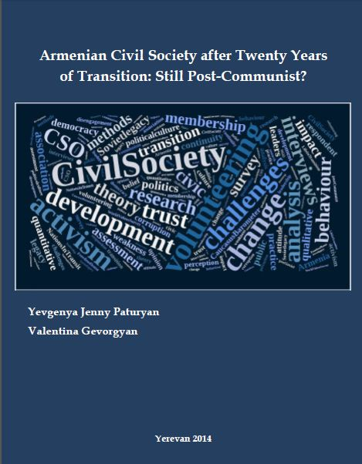
“Civic Activism as a Novel Component of Armenian Civil Society: New Energy and Tensions" 2016
Interaction between civic activists & NGOs
Perceptions of each other
Public perceptions of civic activists & NGOs
Political culture of public participation
Turpanjian Center for Policy Analysis, 2014

Slide 3
Civic Initiatives/Campaigns
Dynamics of development
Similarities/differences among cases
Factors affecting positive resolution
Actors involved

Slide 4
Stages of Civil Society Development
Soviet Armenian civil society (1921-1990)
Delimiting practice of citizen engagement
Oversight and control over individuals’ behaviour
Mandatory volunteering (as a result of which the concept and understanding of it became distorted)
BUT some major examples of unprecedented social mobilisation
Mushrooming of NGOs (1991-2006)
Life dramatically changed (war, severe economic conditions)
Foreign donors welcome
Number of NGOs: 900 (1995), 2756 (2002), 4149 (2015)
Limited impact: quantity, not quality
4

Slide 5
Stages of Civil Society Development, cont-ed
Civic Activism (2008-present)
Novel, but not brand new (rather a reawakening of the dormant potential)
But: some aspects making initiatives NEW, should be recognised:
a) Single-purposed
b) Against a governmental policy/decision
c) Spontaneous
d) Youth-driven
e) Supported by social media
5

Slide 6
Methods
a) 15 semi-structured interviews with civic activists (leaders and organisers of selected civic campaigns)
MAXQDA qualitative data analysis software
b) Participant observations
“No to Plunder”, Electricity Price Hike, Yerevan June 2015
c) Four case-studies
i) Positive resolution
ii) Negative resolution
iii) Most recent (and biggest turnout)
iv) Second biggest turnout
6

Slide 7
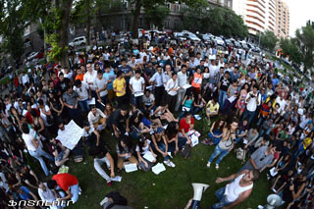
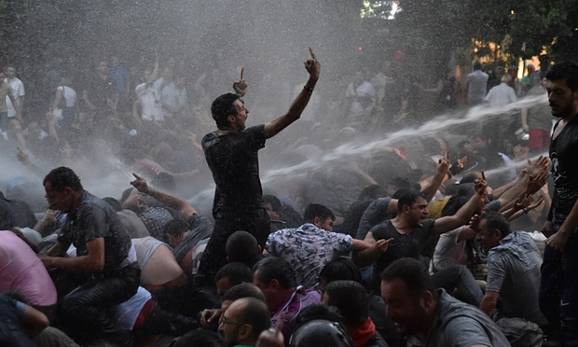
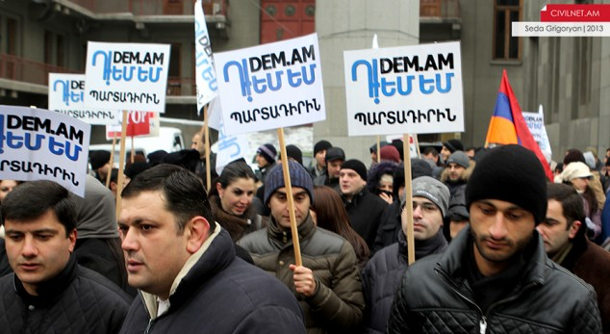
Case Studies
“Save Teghut Civic Initiative”
“We Pay 100 Drams”
“Dem Am” (I Am Against)
“No to Plunder!”

Slide 8
Problems in case studies
No discourse about planned change
Preservation of internal values, leading to destruction outside. My family is OK – don’t mind the rest. However this is exactly what will lead to a total destruction. Perhaps a cultural, a mentality issue
Disconnect between authorities, journalists and public

Slide 9
Achievements by youth
Strength in knowledge and action in progress
Gradually becoming citizens through civic activism, through participation in informal campaigns against governmental decisions
Civic activism helps in becoming a ‘genuine’ citizen of the country
Framing thing: most of the time initiatives are “against smth” but when changed to “for” it entails positive resolution

Slide 10
Analysis (1) Initiatives differ in:
Time frames: From one week to eight years
Ways issues get addressed (and thus resolved): Financial issues get more attention, however, on the other hand: most of the times people just need a trigger to go out. A spark. #ElectricYerevan quote: “Not the issue itself, but water cannons have mobilised the people.” (Activist, 25, Female)
Good turnout, poor framing abilities. Potential to mobilise, lack of ideas.
Usage of techniques
Most of the times
Actors involved
More females with every case
Selected NGOs involvement
10

Slide 11
What we have learned so far:
Importance of learning lessons from previous campaigns
Failure of older generations to share their mistakes and experience with youth today, not to repeat the same
Female engagement
balances conflicting situations
creates working environment
leads to positive resolution

Slide 12
Civic Initiatives/Campaigns
Analysis (2)
Dynamics of development
Similarities/differences among cases
Factors affecting positive resolution
Actors involved

Slide 13
Valentina Gevorgyan Research Associate vgevorgyan@aua.am
THANK YOU
Turpanjian Center for Policy Analysis American University of Armenia www.tcpa.aua.am
URL: http://tcpa.aua.am/what-we-do/

